Slide 1

Electronics - I
Digital Electronics

Slide 2
Number system

Slide 3
Numbers
Every number system is associated with a base or radix
A positional notation is commonly used to express numbers
The decimal system has a base of 10 and uses symbols (0,1,2,3,4,5,6,7,8,9) to represent numbers
An octal number system has a base 8 and uses symbols (0,1,2,3,4,5,6,7)
What decimal number does it represent?

Slide 4
A hexadecimal system has a base of 16
Number | Symbol
0 | 0
1 | 1
2 | 2
3 | 3
4 | 4
5 | 5
6 | 6
7 | 7
8 | 8
9 | 9
10 | A
11 | B
12 | C
13 | D
14 | E
15 | F
How do we convert it into decimal number?

Slide 5
A Binary system has a base 2 and uses only two symbols
0, 1 to represent all the numbers
2⁰ | 1
2¹ | 2
2² | 4
2³ | 8
2⁴ | 16
2⁵ | 32
2⁶ | 64
2⁷ | 128
2⁸ | 256
2⁹ | 512
2¹⁰ | 1024(K)
2²⁰ | 1048576(M)
Which decimal number does this correspond to ?
1 1 0 1 . 1 0 0 1
2⁻⁴
2³
2²
2¹
2⁰
2⁻²
2⁻¹
2⁻³
2⁻¹ | 2⁻² | 2⁻³ | 2⁻⁴ | 2⁻⁵ | 2⁻⁶
0.5 | 0.25 | 0.125 | 0.0625 | 0.03125 | 0.015625

Slide 6
Developing Fluency with Binary Numbers
1 1 0 0 1 = ?
25
1100001 = ?
64+32+1=97
0.101 = ?
0.5+0.125=0.625
11.001 = ?
3+0.125=3.125

Slide 7
Converting decimal to binary number
Convert 45 to binary number
Divide both sides by 2

Slide 8
Divide both sides by 2

Slide 10
Converting decimal to binary number
Method of successive division by 2
45
remainder
22
1
11
0
5
1
2
1
45 = 1 0 1 1 0 1
1
0
0
1

Slide 11
Convert (153)₁₀ to octal number system
Divide both sides by 8
153
remainder
19
1
2
3
153 = (231)₈
0
2

Slide 12
Converting decimal to binary number
Convert (0.35)₁₀ to binary number
How do we find the b₋₁ b₋₂ …coefficients?
Multiply both sides by 2

Slide 13
Multiply both sides by 2
Note that ½+1/4+1/8+……≤1

Slide 14
Converting decimal to binary number
0.125 = ?
0 .
125
x2
0 .
25
x2
0 .
5
x2
0.125 = (.001)₂
1.
0
0 .
8125
0.8125 = ?
x2
1 .
625
x2
1 .
25
x2
0.8125 = (.1101)₂
0.
5
x2
1.
0

Slide 15
Binary numbers
Least significant
bit or LSB
Most significant bit or MSB
1011000111
This is a 10 bit number
Binary digit = bit
decimal | 2bit | 3bit | 4bit | 5bit
0 | 00 | 000 | 0000 | 00000
1 | 01 | 001 | 0001 | 00001
2 | 10 | 010 | 0010 | 00010
3 | 11 | 011 | 0011 | 00011
4 |  | 100 | 0100 | 00100
5 |  | 101 | 0101 | 00101
6 |  | 110 | 0110 | 00110
7 |  | 111 | 0111 | 00111
8 |  |  | 1000 | 01000
9 |  |  | 1001 | 01001
10 |  |  | 1010 | 01010
11 |  |  | 1011 | 01011
12 |  |  | 1100 | 01100
13 |  |  | 1101 | 01101
14 |  |  | 1110 | 01110
15 |  |  | 1111 | 01111
N-bit binary number can represent numbers from 0 to 2^{N} -1

Slide 16
Converting Binary to Hex and Hex to Binary
Number | Symbol
0(0000) | 0
1(0001) | 1
2(0010) | 2
3(0011) | 3
4(0100) | 4
5(0101) | 5
6(0110) | 6
7(0111) | 7
8(1000) | 8
9(1001) | 9
10(1010) | A
11(1011) | B
12(1100) | C
13(1101) | D
14(1110) | E
15(1111) | F
h₁
h₀

Slide 17
Binary Addition/Subtraction

Slide 18
Complement of a number
9’s complement
Decimal system:
10’s complement
9’s complement of n-digit number x is 10^{n} -1 -x
10’s complement of n-digit number x is 10^{n} -x
9’s complement of 85 ?

Slide 19
Complement of a binary number
1’s complement
Binary system:
2’s complement
1’s complement of n-bit number x is 2^{n} -1 -x
2’s complement of n-bit number x is 2^{n} -x
1’s complement of 1011 ?
1’s complement is simply obtained by flipping a bit (changing 1 to 0 and 0 to 1)

Slide 20
Leave all least significant 0’s as they are, leave first 1 unchanged and then flip all subsequent bits

Slide 21
Advantages of using 2’s complement
Can we carry out Y = X₁ – X₂ using such an adder?
Note that carry will be there only if x₁ – x₂ is positive as 2^{N} is N+1 bits (1 followed by N zeros)

Slide 22
Advantages of using 2’s complement
Note that carry will be there only if x₁ – x₂ is positive as 2^{N} is N+1 bits (1 followed by N zeros)
A zero carry implies a negative number whose magnitude (x₂ – x₁) can be found as follows:

Slide 23
Example
10
0100
0100
1
0
6
1010

Slide 24
Example
6
1100
0100
0
1
10
0110
It makes sense to use adder as a subtractor as well provided additional circuit required for carrying out 2’s complement is simple

Slide 25
Subtraction using 10’s complement
5
5
8
1
0
3
10-3=7
This way of subtraction would make sense only if subtracting a number x₂ from 10^{N} is much simpler than directly subtracting it directly from x₁

Slide 26
Representing positive and negative binary numbers
One extra bit is required to carry sign information. Sign bit = 0
Represents positive number and Sign bit = 1 represents negative number
decimal | Signed Magnitude
0 | 0000
1 | 0001
2 | 0010
3 | 0011
4 | 0100
5 | 0101
6 | 0110
7 | 0111
-0 | 1000
-1 | 1001
-2 | 1010
-3 | 1011
-4 | 1100
-5 | 1101
-6 | 1110
-7 | 1111
decimal | Signed 1’s complement
0 | 0000
1 | 0001
2 | 0010
3 | 0011
4 | 0100
5 | 0101
6 | 0110
7 | 0111
-0 | 1111
-1 | 1110
-2 | 1101
-3 | 1100
-4 | 1011
-5 | 1010
-6 | 1001
-7 | 1000
decimal | Signed 2’s complement
0 | 0000
1 | 0001
2 | 0010
3 | 0011
4 | 0100
5 | 0101
6 | 0110
7 | 0111
-1 | 1111
-2 | 1110
-3 | 1101
-4 | 1100
-5 | 1011
-6 | 1010
-7 | 1001

Slide 27
If we represent numbers in 2’s complement
form carrying out subtraction is same as addition
Answer is in 2’s complement form

Slide 28
Example
2’s complement is 0011 = 3
2’s complement is 0111 = 7

Slide 29
Boolean algebra

Slide 30
Boolean Algebra
Algebra on Binary numbers
False
A variable x can take two values {0,1}
No
0
Low voltage
Basic operations:
True
Yes
1
High voltage
Y is 1 if and only if both x₁ and x₂ are 1, otherwise zero
Truth Table

Slide 31
Basic operations:
Y is 1 if either x₁ and x₂ is 1. Or y= 0 if and only if both variables are zero

Slide 32
Boolean Algebra
Basic Postulates
Basic Theorems

Slide 33
Proving theorems

Slide 34
Proving theorems
DeMorgan’s theorem

Slide 35
Simplification of Boolean expressions

Slide 36
Function of Boolean variables
y
x
Y = 1 when x₁ is 0 and x₂ is 1
Boolean expression

Slide 37
Obtaining Boolean expressions from truth Table

Slide 38
Obtaining Boolean expressions from truth Table
Instead of writing expressions as sum of terms that make y equal to 1, we can also write expressions using terms that make y equal to 0

Slide 40
Obtaining Boolean expressions from truth Table
Sum of Products (SOP) form
Product of Sum (POS) form

Slide 41
Implementation of boolean expressions

Slide 42
Implementing Boolean expressions
Elementary Gates
Why call it a gate?

Slide 44
Y is 1 if only one variable is 1 and the other is zero
Y is 1 if only both variables are either 0 or 1

Slide 45
Gates with more than 2 inputs
Y = 1 only if odd number of inputs is 1

Slide 46
Implementing Boolean expressions using gates

Slide 47
Implementing gates using Switches
Voltage controlled Switch SN:
Switch is closed if voltage x is HIGH
Switch is open if voltage x is LOW
Voltage controlled Switch SP:
Switch is closed if voltage x is LOW
Switch is open if voltage x is HIGH
We have seen earlier (in class 12) that transistors act as switches !

Slide 48
Switch is closed if voltage x is HIGH
Switch is open if voltage x is LOW
Switch is closed if voltage x is LOW
Switch is open if voltage x is HIGH
closed
HIGH
LOW
1
0
NOT gate
open

Slide 49
NAND Gate

Slide 50
NOR Gate

Slide 51
Design Overview

Slide 52
Sop and POS representations

Slide 53
Representation of Boolean Expressions
A minterm is a product that contains all the variables used in a function

Slide 54
Three variable functions

Slide 55
Product of Sum Terms Representation
F1 = (x+y)(x’ + y’) = M₀.M₃ = ∏M₀M₃

Slide 57
Simplification of Boolean Expressions
Simplification of Boolean expression yields : y = x₃ !! which does not require any gates at all !

Slide 58
Goal of Simplification
Goal of simplification is to reduce the complexity of gate circuit. This requires that we minimize the number of gates. Since number of gates depends on number of minterms, one of the goals of simplification is to minimize the number of minterms in SOP expression

Slide 59
This circuit is simpler not just because it uses 4 gates instead of 5 but also because circuit-2 uses one 2-input and three 3-input gates as compared to five 3-input gates used in circuit-1

Slide 60
Goal of Simplification
In the SOP expression:
Minimize number of product terms
Minimize number of literals in each term

Slide 61
Minimization

Slide 62
How do we simplify further?

Slide 63
Simplify
Need a systematic and simpler method for applying these two principles
Karnaugh Map (K map) is a popular technique for carrying out simplification
It represents the information in problem in such a way that the two principles become easy to apply

Slide 64
Karnaugh maps

Slide 65
K-map representation of truth table

Slide 66
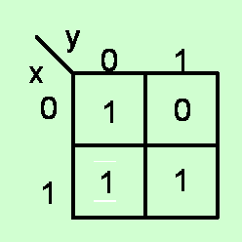

Slide 67
3-variable K-map representation

Slide 69
4-variable K-map representation

Slide 70
Minimization using Kmap
Combine terms which differ in only one bit position. As a result, whatever is common remains.

Slide 72

The idea is to cover all the 1’s with as few and as simple terms as possible

Slide 73
3-variable minimization

Slide 74
3-variable minimization

Slide 75
3-variable minimization

Slide 77
Can we do this ?
Note that each encirclement should represent a single product term. In this case it does not.
We do not get a single product term.
In general we cannot make groups of 3 terms.

Slide 78
Can we use kmap with the following ordering of variables?
Can we combine these two terms into a single term ?
Note that no simplification is possible.
Kmap requires information to be represented

Slide 79
These two terms can be combined into a single term but it is not easy to show that on the diagram.
Kmap requires information to be represented in such a way that it is easy to apply the principle

Slide 80
4-variable minimization
But is this the simplest expression ?

Slide 82
4-variable minimization
Is this the best that we can do ?

Slide 83
Cover the 1’s with minimum number of terms

Slide 84
4-variable minimization

Slide 85
Groups of 4

Slide 87
Groups of 8

Slide 88
Examples

Slide 89
Don’t care terms

Slide 90
Don’t care terms can be chosen as 0 or 1.
Depending on the problem, we can choose the don’t care term
as 1 and use it to obtain a simpler Boolean expression
Don’t care terms should only be included in encirclements if it helps in obtaining a larger grouping or smaller number of groups.

Slide 91
Minimization of Product of Sum Terms using Kmap

Slide 94
Example
Obtain the minimized PoS by suitably using don’t care terms

Slide 95
Design Flow
System Description
Truth Table
Boolean Expression
Minimized
Boolean Expression
Gate Netlist

Slide 96
Mapping of Boolean expression to a Network of
gates available in the library
Library of available Gates | Cost
Inverter | 1
Two input NAND | 2
Three input NAND | 3
AND-OR-Invert | 3

Slide 97
Implementation using specific gates

Slide 98
Implementation using only NAND gates
A SoP expression is easily implemented with NAND gates.

Slide 99
There is a one-to-one mapping between AND-OR network and NAND network

Slide 100
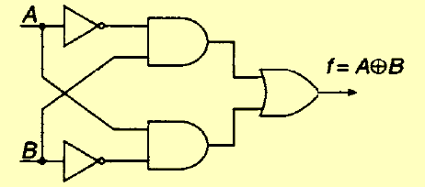
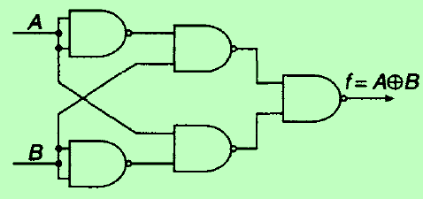
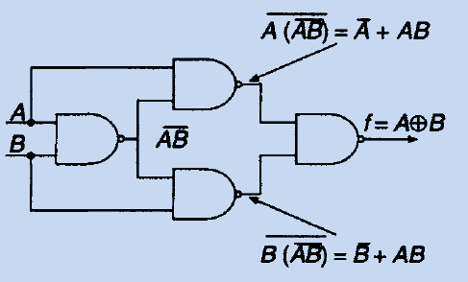
Often there is lot of further optimization that can be done
Consider implementation of XOR gate

Slide 101
Implementation using only NOR gates
To implement using NOR gates, it is easiest to start with minimized Boolean expression in POS form

Slide 102
There is a one-to-one mapping between OR-AND network and NOR network

Slide 103
To implement SoP expression using NOR gates, determine first the corresponding PoS expression and then follow the procedure
outlined earlier
Similarly PoS expression can be implemented as NAND network by first converting it to SoP expression and then following the procedure outlined earlier

Slide 104
Combinational circuit design

Slide 105
Digital Circuits
Combinational Circuits
Sequential Circuits
Output is determined by current values of inputs only.
Output is determined in general by current values of inputs and past values of inputs/outputs as well.

Slide 106
Design of Complex Combinational circuits
Truth table has 2¹⁶ entries
System
Description
Truth
Table
Boolean
expression
Minimized Boolean
expression
Gate
Netlist
This design approach becomes difficult to use

Slide 107
Design system as a network of sub-systems that are of
manageable size and can be implemented using the
earlier approach of truth table, minimization etc.

Slide 108
General Approach
Sub-system-1
Sub-system-2
System
Sub-system-3
There are certain sub-systems or blocks that are used quite often such as :
decoders, encoders
Multiplexers
Adder/Subtractors, Multipliers
Comparators
Parity Generators
……..

Slide 109
Decoders
Maps a smaller number of inputs to a larger set of outputs in general
Active Low

Slide 110
Example

Slide 111
Decoder with Enable Input

Slide 112
Decoder: gate Implementation

Slide 113
A n to 2^{n} decoder is a minterm generator
It can be used to implement any combinational circuit
0
1
0
0
1
1
0

Slide 114
Implementation of a 3-variable function with a 3-to-8 decoder
0
1
0
1
1
1
1
1
0
0
0
1
1
Although it is easy to implement any combinational circuit with this method , it is often very inefficient in terms of gate utilization. Note that this method does not require any minimization.

Slide 115
Implementing larger decoders using simpler ones.
3/8 decoder using 2/4 decoders
E
C
0
How many 2/4 decoders are required to implement a 4/16 decoder ?

Slide 116
1
0
1
1
1
0
0
0
0
0
0
0
0
0

Slide 117
Seven segment decoder
5
5
5
5
5
5
0

Slide 118
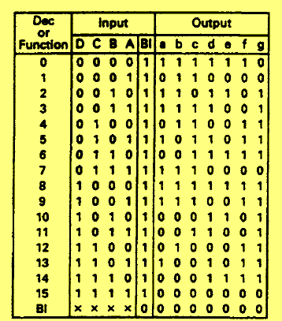
Seven segment decoder

Slide 119
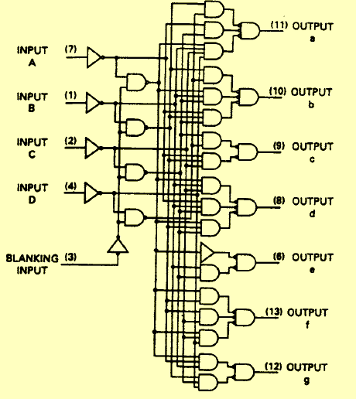
7449 BCD to seven segment decoder

Slide 120
Encoders
An encoder performs the inverse operation of a decoder.

Slide 122
Priority Encoders
D₀
printer
Priority is 3,2,1,0 with user 3 having the highest priority
D₁
D₂
D₃
X, Y have to be determined based on this priority order and the requests to use the resource.

Slide 123
Gray Codes
decimal | Natural Binary | Gray
0 | 0000 | 0000
1 | 0001 | 0001
2 | 0010 | 0011
3 | 0011 | 0010
4 | 0100 | 0110
5 | 0101 | 0111
6 | 0110 | 0101
7 | 0111 | 0100
8 | 1000 | 1100
9 | 1001 | 1101
10 | 1010 | 1111
11 | 1011 | 1110
12 | 1100 | 1010
13 | 1101 | 1011
14 | 1110 | 1001
15 | 1111 | 1000
In the case of natural binary code:
0111-1111-1000
0111-0000-1000
In the case of Gray code, no such problem occurs.
1-bit change as one goes from
one code word to the next.

Slide 124
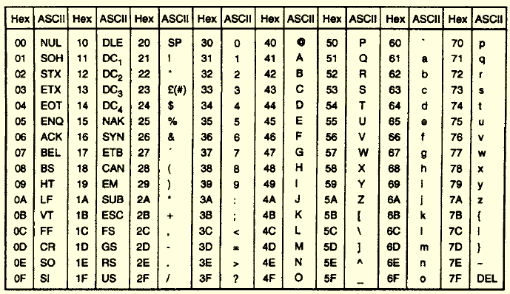
ASCII: American Standard Code for information interchange

Slide 125
Parity
Extra bits are added to aid in error detection and correction
decimal | Binary | Even parity | Odd parity
0 | 000 | 0000 | 0001
1 | 001 | 0011 | 0010
2 | 010 | 0101 | 0100
3 | 011 | 0110 | 0111
4 | 100 | 1001 | 1000
5 | 101 | 1010 | 1011
6 | 110 | 1100 | 1101
7 | 111 | 1111 | 1110
A 1-bit error changes the parity and thus can be detected

Slide 126
Multiplexers
I₀
1
I₀
0
0
0

Slide 128
Mux is often used when resources have to be shared
0
0
a
c
= a+c

Slide 129
Implementing Boolean expressions using Multiplexers
x₂
?
x₂
?
0
0
0
y = x₂ when x₁ = 0
0
1
1
1
0
1
y = x₂ when x₁ = 1
1
1
0

Slide 130
A 3 variable function can be implemented with a 4:1 mux with 2 select lines
0
0
0 0
0 0
0
F = 0 when yz = 00
x
1
0
1
0
0 1
0 1
1
F = x when yz =01
x
1
0
0
1 0
1 0
1
y
z
F = 1 when yz = 10
1
1
0
1 1
1 1
0
F = x when yz = 11
1
1
Mux is more efficient way of implementing combinational circuits as compared to decoders.

Slide 131
Mux. expansion
1
0
I₁
I₁
0
1
0

Slide 132
Mux. expansion
0
1
I₃
0
I₃
1
1

Slide 133
DeMultiplexer

Slide 134
Demultiplexer is very much like a decoder
Data
1
1
0
0
0
0
0

Slide 135
Comparator

Slide 136
A>B
A = B

Slide 137
Adder/Subtractor

Slide 139
4-bit Adder
S₃
S₁
S₀
S₂
C₃
C₂
C₁
0
C₄
A₃
B₃
A₂
B₂
A₁
B₁
A₀
B₀
Ripple Carry Adder (20 gate circuit)

Slide 140
Subtraction
A - B = A + 2’s complement of B
A - B = A + 1’s complement of B+1
A - B = A + B+1
One needs add a circuit for predicting errors resulting from overflow

Slide 141
Adder/Subtractor

Slide 142
Multiplier
B₁ B₀
multiplicand
A₁ A₀
multiplier
A₀B₁ A₀B₀
Partial products
A₁B₁ A₁B₀
C3 C2 C₁ C₀

Slide 143
Sequential circuits

Slide 144
Digital Circuits
Combinational Circuits
Sequential Circuits
Output is determined by current values of inputs only.
Output is determined in general by current values of inputs and past values of inputs/outputs as well.

Slide 145
NOR SR Latch
1
0
0
1
0
S R
Q Q
State
1 0
1 0
SET

Slide 146
NOR SR Latch
Reset
0
1
0
1
0
Set
S R
Q Q
State
1 0
1 0
SET
0 1
0 1
RESET

Slide 147
HOLD State
1
0
1
0
0
S R
Q Q
State
1 0
1 0
SET
0 1
0 1
RESET
0 0
Q Q
HOLD
1 1
0 0
INVALID

Slide 148
1
0
Both the outputs are well defined and 0. the first problem is that we do not get complementary output.
1
0
A more serious problem occurs when we switch the latch to the hold state by changing RS from 11 → 00 . Suppose the inputs do not change simultaneously and we get the situation 11 → 01* → 00
1
0
1
0
0
1
0
0
1
1
0
0
Q = 1

Slide 149
1
0
1
0
1
0
0
1
1
0
0
0
Q = 1
Suppose the inputs change as RS = 11 → 10* → 00
1
1
0
0
0
0
1
1
1
0
0
0
Q = 0
So although output is well defined when we apply RS = 11, it becomes unpredictable once we switch the latch to hold state by applying RS = 00. That is why RS = 11 is not used as an input combination.

Slide 150
The error can occur also due to unequal gate delays.
1
0
0
0
0
1
0
1
0
0
0
0
0
Suppose gate-1 is faster
Q = 1
On the other hand suppose that gate-2 is faster.
1
0
0
0
0
0
0
1
0
1
0
0
0
Again the output is unpredictable in general
Q = 0

Slide 151
NAND Latch
S R
Q Q
State
0 1
1 0
SET
1 0
0 1
RESET
1 1
Q Q
HOLD
0 0
1 1
INVALID

Slide 152
RS NAND Latch with Enable
1
Hold State
0
1
1

Slide 153
D latch
1
1
1
1
0
0
If EN = 1 then Q = D otherwise the latch is in Hold state

Slide 154
Synchronous Sequential Circuits
n
Data is stable when clock is high
X(n)

Slide 155
Example
1
0
0
0
0
1
0
0
y
z

Slide 156
Example
1
0
1
1
1
0
1
1
0
1
0
1
y
z

Slide 157
Problem with Latch
Circuits are designed with the idea there would be single change in output or memory state in single clock cycle.
clk
y
z

Slide 158
Edge Triggered Latch or Flip-flop
Positive edge triggered flipflop

Slide 159
Negative Edge Triggered Latch or Flip-flop

Slide 160
Master-Slave D Flip-flop
master
slave
Master
Slave

Slide 161
Positive edge triggered Flip-flop
1
1
→0
0
→1
0
→1
1
1
→0
1
0

Slide 162
Positive edge triggered Flip-flop
1
0
1
1
1
0
1
→0
→1
0
A change in input has no effect if it occurs after the clock edge

Slide 163
Positive edge Triggered Flip-flop with Asynchronous Reset
1
0
1
0

Slide 164
Characteristic table
Given a input and the present state of the flip-flop,
what is the next state of the flip-flop
(D)
0
0
1
1
JK Flip-flop
J K
0 0
Q(t)
0 1
0
1 0
1
1 1
Q(t)
→Characteristic equation

Slide 165
Toggle or T Flip-flop
(T)
0
Q(t)
1
Q(t)
Excitation Table
What inputs are required to effect a particular state change
T
0
1
1
0

Slide 166
Excitation Table
J K
0 X
1 X
X 1
X 0
D
0
1
0
1

Slide 167
Convert a D FF to JK FF
Q(t)
0
1
Q(t)

